Slide 1
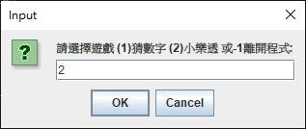
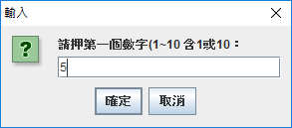
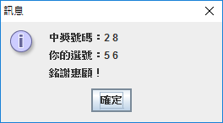
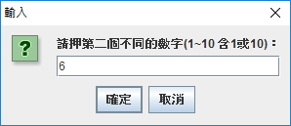
In-class Assignment 4 (A班)
樂透開獎程式(基礎版) ➔注意：程式需包含gmae1()等完整的程式
Continue with Example 5_2. Use what you have learnt to write a method called “game2()” to develop the second game: a simple Java Lotto(樂透開獎). Assume that the range of two lotto numbers is [1~10]. As the following screenshots show, the player is asked to enter 2 numbers and then the program checks and shows the result:
If the two numbers are correct: First prize (頭彩). A message dialog shows to congratulate the player.
If one of the guess numbers is correct: Second prize. A message dialog shows with corresponding message of congrats.
If none of the numbers hit the wining numbers. A message dialog shows to thank the player.

Slide 2
In-class Assignment 4 (B班)
樂透開獎程式(基礎版) ➔注意：程式需包含gmae1()等完整的程式
Continue with Example 5_2. Use what you have learnt to write a method called “game2()” to develop the second game: a simple Java Lotto(樂透開獎). Assume that the range of two lotto numbers is [1~10]. As the following screenshots show, the player is asked to enter 2 numbers and then the program checks and shows the result:
If the two numbers are correct: First prize (頭彩). A message dialog shows to congratulate the player.
If one of the guess numbers is correct: Second prize. A message dialog shows with corresponding message of congrats.
If none of the numbers hit the wining numbers. A message dialog shows to thank the player.

